Slide 1
Trees
Make Money Fast!
Stock
Fraud
Ponzi
Scheme
Bank
Robbery
© 2013 Goodrich, Tamassia, Goldwasser
Trees
Notes:
Trees

Slide 2
Linear Data Structures
Data structures we have studied so far:
  Arrays
  Stacks, queues, and deques
  Singly-linked lists and doubly-linked lists
Common property
  Their visual representation forms a straight line
Trees are nonlinear data structures
  Binary trees: one of the simplest nonlinear data structures

Slide 3
What is a Tree
In computer science, a tree is an abstract model of a hierarchical structure
A tree consists of nodes with a parent-child relation
Applications:
  Organization charts
  File systems
  Programming environments
Computers”R”Us
Sales
Manufacturing
R&D
US
International
Laptops
Desktops
Europe
Asia
Canada
© 2013 Goodrich, Tamassia, Goldwasser
Trees

Slide 4
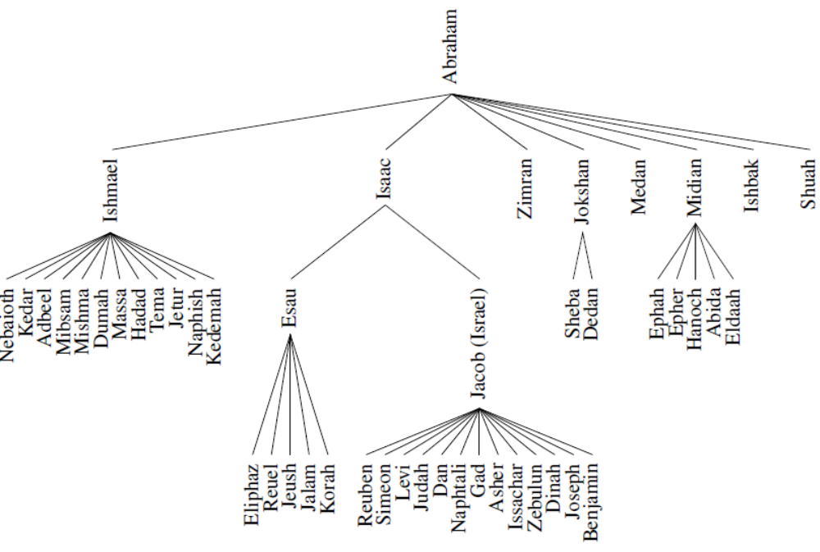
Family Tree
© 2013 Goodrich, Tamassia, Goldwasser
Trees

Slide 5
Tree Terminology
Root: node without parent (A)
Internal node: node with at least one child (A, B, C, F)
External node (a.k.a. leaf ): node without children (E, I, J, K, G, H, D)
Ancestors of a node: parent, grandparent, grand-grandparent, etc.
Depth of a node: number of ancestors
Height of a tree: maximum depth of any node (3)
Descendant of a node: child, grandchild, grand-grandchild, etc.
Subtree: tree consisting of a node and its descendants
A
subtree
B
C
D
E
F
G
H
I
J
K
© 2013 Goodrich, Tamassia, Goldwasser
Trees
Notes:
Trees

Slide 6
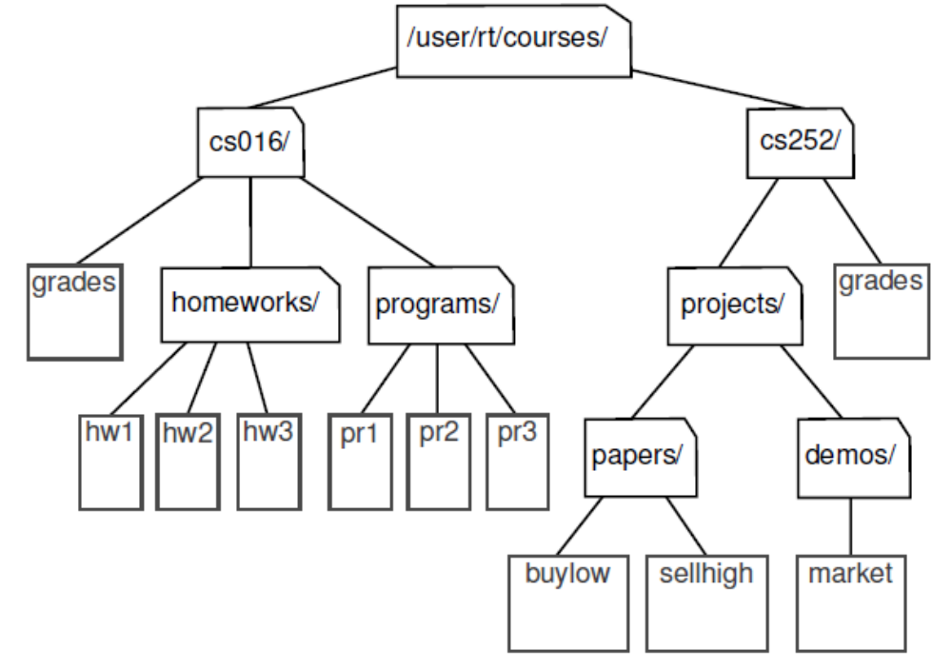
Computer File Systems
© 2013 Goodrich, Tamassia, Goldwasser
Trees
Notes:
Trees

Slide 7
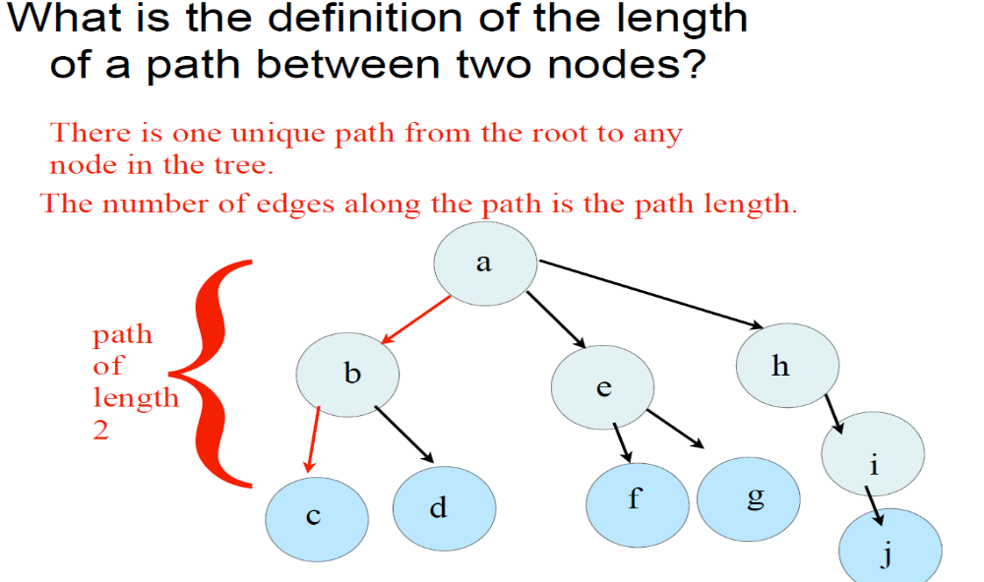
Path between two nodes
© 2013 Goodrich, Tamassia, Goldwasser
Trees

Slide 8
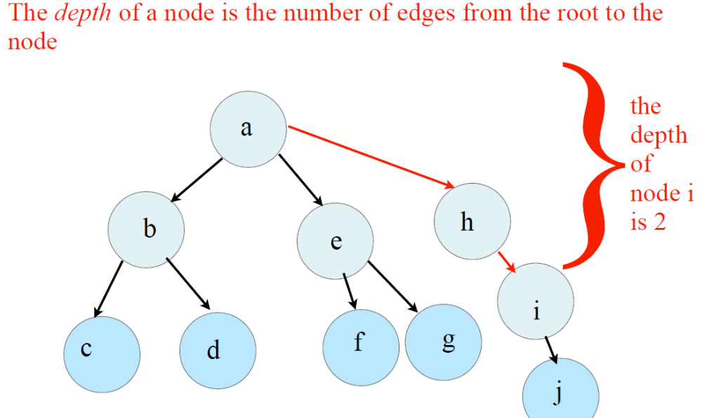
Depth of a Tree
© 2013 Goodrich, Tamassia, Goldwasser
Trees

Slide 9
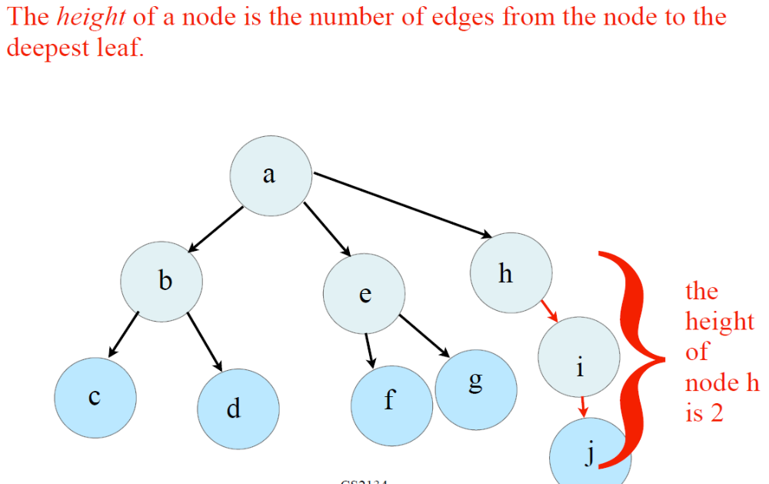
Height of a tree
© 2013 Goodrich, Tamassia, Goldwasser
Trees

Slide 10
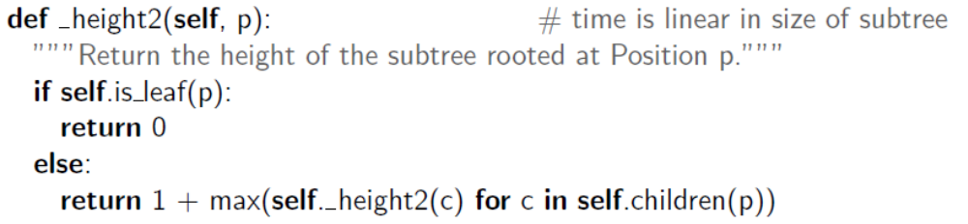
Height of a tree
The height of a position p in a tree T is also defined recursively:
• If p is a leaf, then the height of p is 0.
• Otherwise, the height of p is one more than the maximum of the heights of p’s children.
The height of a nonempty tree T is the height of the root of T.
© 2013 Goodrich, Tamassia, Goldwasser
Trees

Slide 11
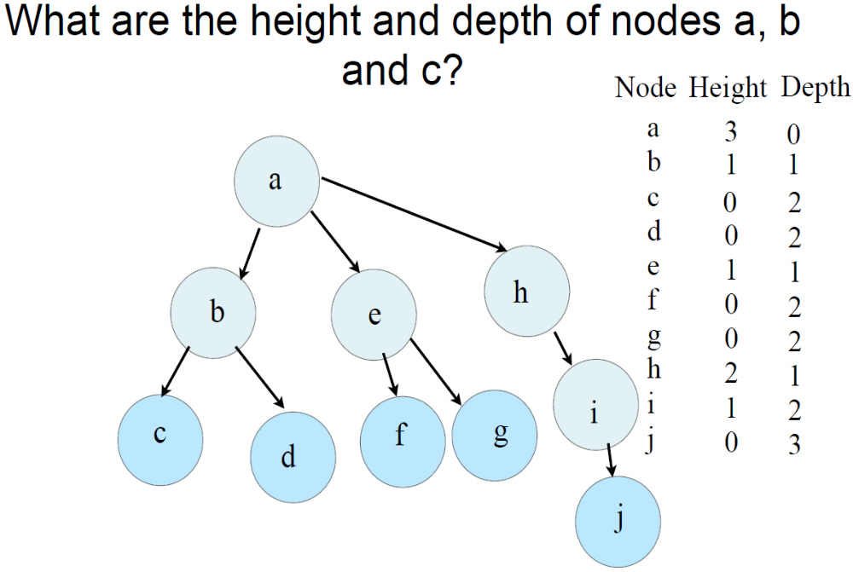
© 2013 Goodrich, Tamassia, Goldwasser
Trees

Slide 12
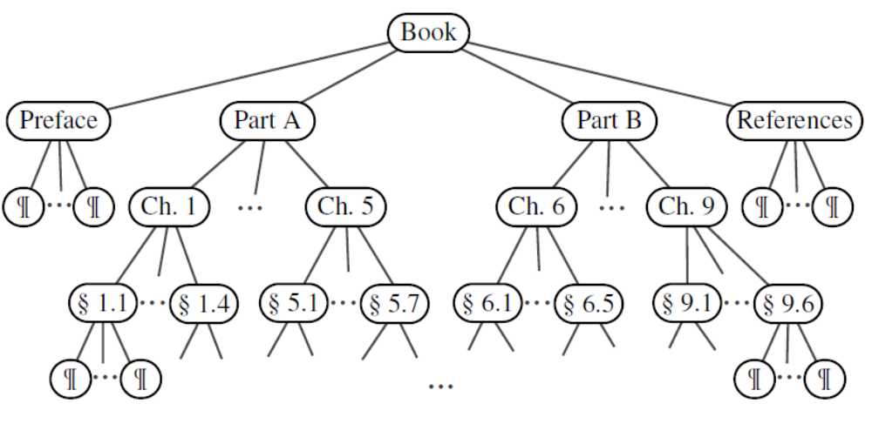
Ordered Trees
A tree is ordered if there is a meaningful linear order among the children of each node
© 2013 Goodrich, Tamassia, Goldwasser
Trees

Slide 13
Question?
If a tree has n nodes how many edges does it have?
© 2013 Goodrich, Tamassia, Goldwasser
Trees

Slide 14
Binary Trees
A binary tree is a tree with the following properties:
  Each internal node has at most two children (exactly two for proper/full binary trees)
  The children of a node are an ordered pair
We call the children of an internal node left child and right child
Alternative recursive definition: a binary tree is either
  a tree consisting of a single node, or
  a tree whose root has an ordered pair of children, each of which is a binary tree
Applications:
  arithmetic expressions
  decision processes
  searching
A
B
C
D
E
F
G
H
I
© 2013 Goodrich, Tamassia, Goldwasser
Trees
Notes:
Trees

Slide 15
Arithmetic Expression Tree
Binary tree associated with an arithmetic expression
  internal nodes: operators
  external nodes: operands
Example: arithmetic expression tree for the expression (2 × (a − 1) + (3 × b))
+
×
×
2
−
3
b
a
1
© 2013 Goodrich, Tamassia, Goldwasser
Trees

Slide 16
Decision Tree
Binary tree associated with a decision process
  internal nodes: questions with yes/no answer
  external nodes: decisions
Example: dining decision
Want a fast meal?
Yes
No
How about coffee?
On expense account?
Yes
No
Yes
No
Starbucks
Spike’s
Al Forno
Café Paragon
© 2013 Goodrich, Tamassia, Goldwasser
Trees

Slide 17
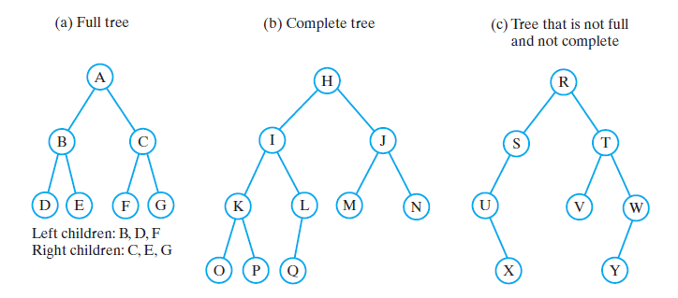
Binary Trees
Three binary trees
Notes:
Trees

Slide 18
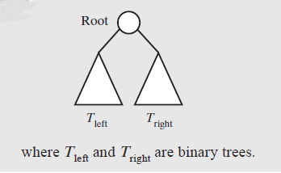
Binary Trees
A binary tree is empty or has the above form

Slide 19
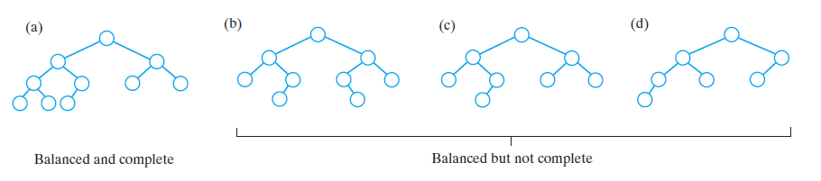
Binary Trees
Some binary trees that are height balanced

Slide 20
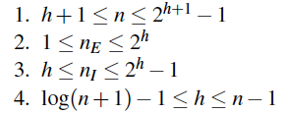
Properties of Binary Trees
Properties:
Notation
  n number of nodes
  e number of external nodes
  i number of internal nodes
  h height
© 2013 Goodrich, Tamassia, Goldwasser
Trees
Notes:
Trees

Slide 21
Properties of Proper Binary Trees
A full binary tree (sometimes proper binary tree or 2-tree) is a tree in which every node other than the leaves has two children.
Notation
  n number of nodes
  e number of external nodes
  i number of internal nodes
  h height
Properties:
  e = i + 1
  n = 2e − 1
  h ≤ i
  h ≤ (n − 1)/2
  e ≤ 2^{h}
  h ≥ log₂ e
  h ≥ log₂ (n + 1) − 1
© 2013 Goodrich, Tamassia, Goldwasser
Trees
Notes:
A full binary tree (sometimes proper binary tree or 2-tree) is a tree in which every node other than the leaves has two children.
Trees

Slide 22
Traversals of A Tree
Definition
  Visit, or process, each data item exactly once
  Visit can be delayed
    Traversal can pass through a node without processing it
Order of the visits is not unique
First consider traversals of a binary tree
  Somewhat easier to understand

Slide 23
Tree Traversals (Binary Tree)
• pre-order
–visit root
–traverse left subtree
–traverse right subtree
• post-order
–traverse left subtree
–traverse right subtree
–visit root
• in-order
–traverse left subtree
–visit root
–traverse right subtree
• level-order (
–visit root
– traverse level 1 nodes
– traverse level 2 nodes
– -----
– -----
– -----
– traverse last level nodes
* For Proper tree, level order is same as Breadth First Traversal
© 2013 Goodrich, Tamassia, Goldwasser
Trees

Slide 24
Preorder Traversal (any tree)
A traversal visits the nodes of a tree in a systematic manner
In a preorder traversal, a node is visited before its descendants
Application: print a structured document
Algorithm preOrder(v)
  visit(v)
  for each child w of v
  preorder (w)
1
Make Money Fast!
2
5
9
1. Motivations
2. Methods
References
3
4
6
7
8
1.1 Greed
1.2 Avidity
2.1 Stock
Fraud
2.2 Ponzi
Scheme
2.3 Bank
Robbery
© 2013 Goodrich, Tamassia, Goldwasser
Trees

Slide 25
Postorder Traversal (any tree)
In a postorder traversal, a node is visited after its descendants
Application: compute space used by files in a directory and its subdirectories
Algorithm postOrder(v)
  for each child w of v
  postOrder (w)
  visit(v)
9
cs16/
8
3
7
homeworks/
programs/
todo.txt
1K
1
2
4
5
6
h1c.doc
3K
h1nc.doc
2K
DDR.java
10K
Stocks.java
25K
Robot.java
20K
© 2013 Goodrich, Tamassia, Goldwasser
Trees

Slide 26
Inorder Traversal (binary tree)
In an inorder traversal a node is visited after its left subtree and before its right subtree
Application: draw a binary tree
  x(v) = inorder rank of v
  y(v) = depth of v
Algorithm inOrder(v)
  if v has a left child
    inOrder (left (v))
  visit(v)
  if v has a right child
    inOrder (right (v))
6
2
8
1
4
7
9
3
5
© 2013 Goodrich, Tamassia, Goldwasser
Trees

Slide 27
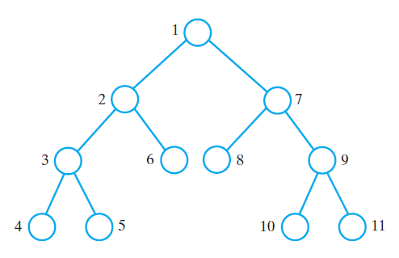
Traversals of a Binary Tree
The visitation order of a preorder traversal

Slide 28
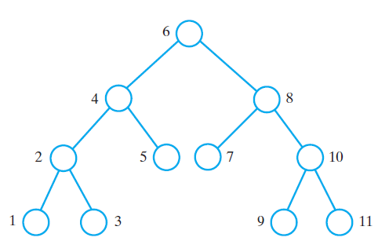
Traversals of a Binary Tree
The visitation order of an inorder traversal

Slide 29
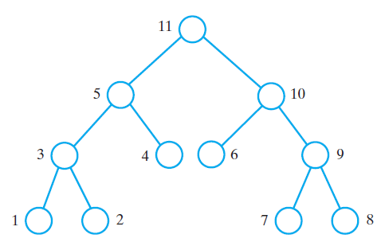
Traversals of a Binary Tree
The visitation order of a postorder traversal

Slide 30
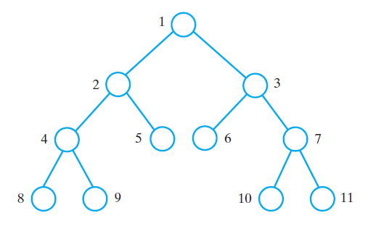
Traversals of a Binary Tree
The visitation order of a level-order traversal

Slide 31
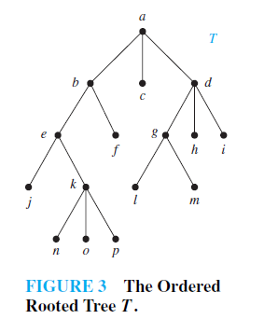
Practice
Pre-order, Post-Order, In-order

Slide 32
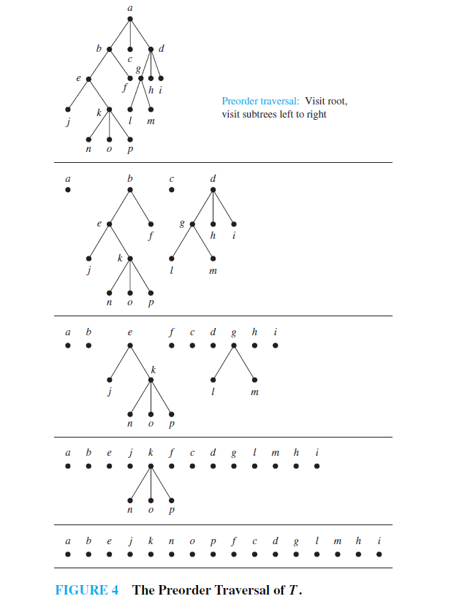

Slide 33
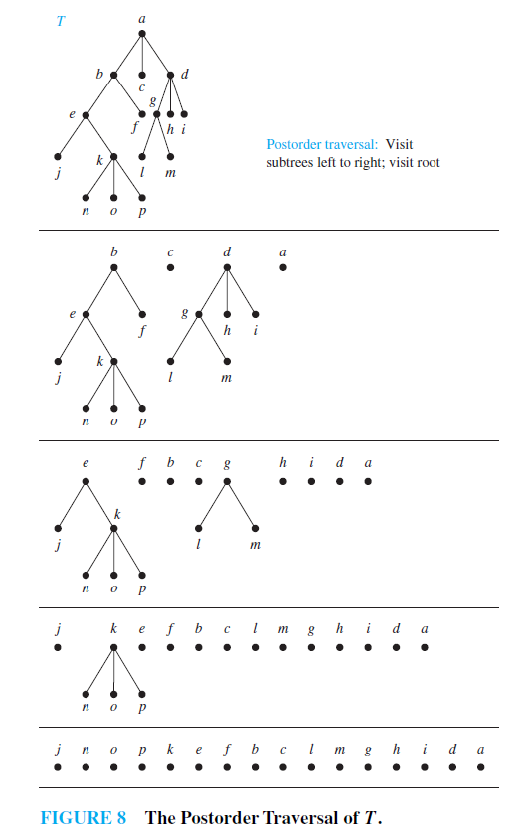

Slide 34
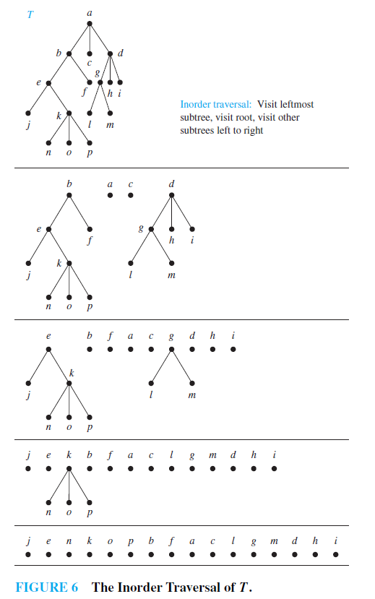

Slide 35
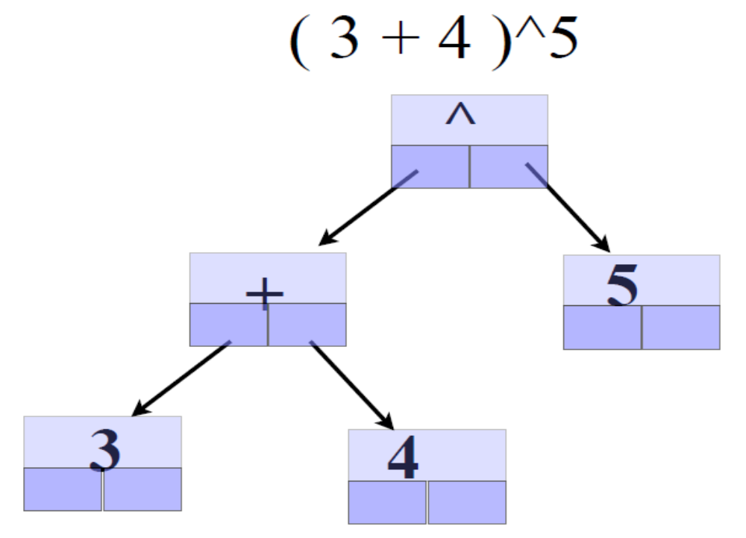
Expression Tree
Pre-order Traversal: ?
Post-order Traversal: ?
Level-order Traversal: ?
© 2013 Goodrich, Tamassia, Goldwasser
Trees

Slide 36
Print Arithmetic Expressions
Specialization of an inorder traversal
  print operand or operator when visiting node
  print “(“ before traversing left subtree
  print “)“ after traversing right subtree
Algorithm printExpression(v)
  if v has a left child
  print(“(’’)
    inOrder (left(v))
  print(v.element ())
  if v has a right child
    inOrder (right(v))
  print (“)’’)
+
×
×
2
−
3
b
((2 × (a − 1)) + (3 × b))
a
1
© 2013 Goodrich, Tamassia, Goldwasser
Trees

Slide 37
Evaluate Arithmetic Expressions
Specialization of a postorder traversal
  recursive method returning the value of a subtree
  when visiting an internal node, combine the values of the subtrees
Algorithm evalExpr(v)
  if is_leaf (v)
    return v.element ()
  else
  x ← evalExpr(left (v))
  y ← evalExpr(right (v))
  ◊ ← operator stored at v
    return x ◊ y
+
×
×
2
−
3
2
5
1
© 2013 Goodrich, Tamassia, Goldwasser
Trees

Slide 38
Simple Binary Tree
(w/o parent)
class TreeWithoutParent:
def __init__(self,element,left=None,right=None):
self._element = element
self._left = left
self._right = right
def __str__(self):
return str(self._element)
+
×
1
2
3
tree = TreeWithoutParent('+', TreeWithoutParent(1), TreeWithoutParent('*', TreeWithoutParent(2), TreeWithoutParent(3)))
© 2013 Goodrich, Tamassia, Goldwasser
Trees

Slide 39
Simple Binary Tree
(w/o parent)
def printTreePreOrder(tree):
if tree == None:
return
print(tree._element,end=" ")
printTreePreOrder(tree._left)
printTreePreOrder(tree._right)
def printTreePostOrder(tree):
if tree == None:
return
printTreePostOrder(tree._left)
printTreePostOrder(tree._right)
print(tree._element,end=" ")
+
×
1
2
3
def printTreeInOrder(tree):
if tree == None:
return
printTreeInOrder(tree._left)
print(tree._element,end=" ")
printTreeInOrder(tree._right)
© 2013 Goodrich, Tamassia, Goldwasser
Trees
Notes:
PreOrder:
+ 1 * 2 3
PostOrder:
1 2 3 * +
InOrder:
1 + 2 * 3
Trees

Slide 40
Simple Binary Tree
(with parent)
class TreeWithParent:
def __init__(self,element, parent= None, left=None, right=None):
self._element = element
self._parent = parent
self._left = left
self._right = right
def __str__(self):
return str(self._element)
left = TreeWithParent(3)
right = TreeWithParent(4)
tree = TreeWithParent(1,None,left,right)
left._parent = tree
right._parent = tree
1
3
4
© 2013 Goodrich, Tamassia, Goldwasser
Trees

Slide 41
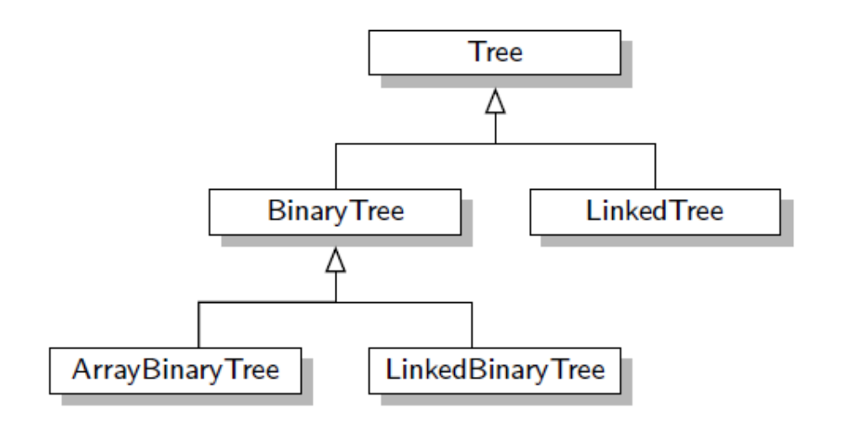
Hierarchy of Classes for representing Diff. Forms of Trees
© 2013 Goodrich, Tamassia, Goldwasser
Trees
Notes:
Trees

Slide 42
Tree ADT
We use abstract nodes
Generic methods:
  Integer len()
  Boolean is_empty()
  Iterator nodes()
  Iterator iter()
Accessor methods:
  node root()
  node parent(node)
  Iterator children(node)
  Integer num_children(node)
Query methods:
  Boolean is_leaf(node)
  Boolean is_root(node)
Update method:
  element replace (p, o)
Additional update methods may be defined by data structures implementing the Tree ADT
© 2013 Goodrich, Tamassia, Goldwasser
Trees

Slide 43
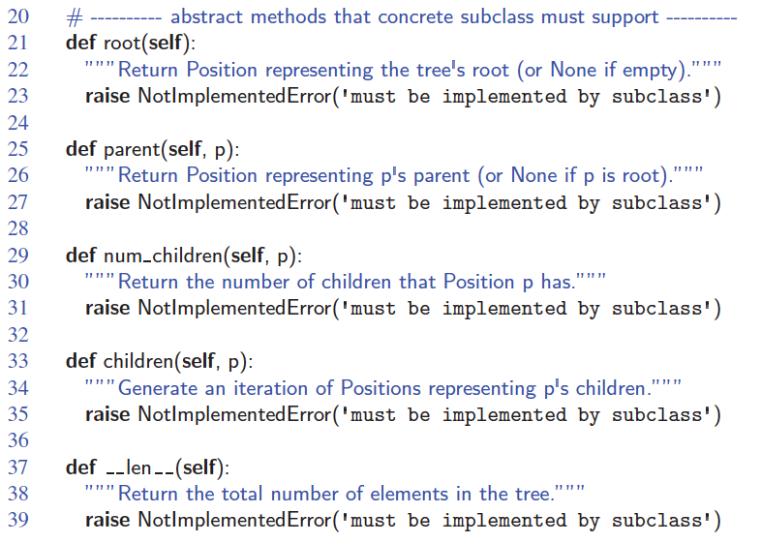
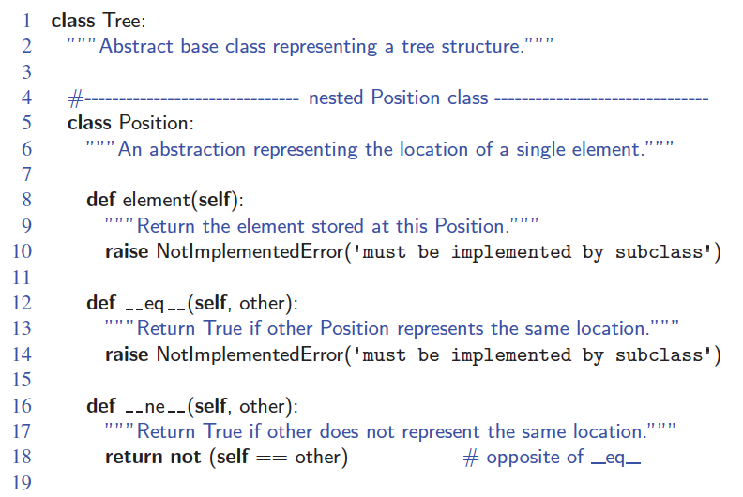
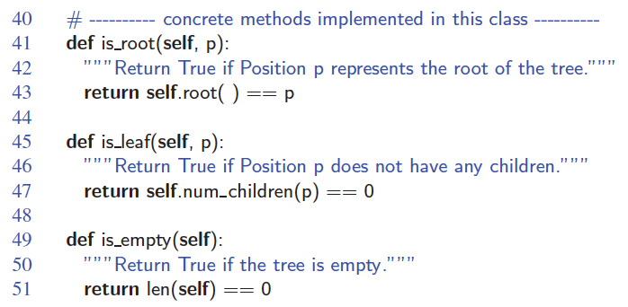
Abstract Tree Class in Python
© 2013 Goodrich, Tamassia, Goldwasser
Trees

Slide 44
BinaryTree ADT
The BinaryTree ADT extends the Tree ADT, i.e., it inherits all the methods of the Tree ADT
Additional methods:
  node left(node)
  node right(node)
  node sibling(node)
Update methods may be defined by data structures implementing the BinaryTree ADT
© 2013 Goodrich, Tamassia, Goldwasser
Trees

Slide 45
Linked Structure for Trees
A node is represented by an object storing
  Element
  Parent node
  Sequence of children nodes
∅
B
∅
∅
A
D
F
B
A
D
F
C
E
∅
∅
C
E
© 2013 Goodrich, Tamassia, Goldwasser
Trees

Slide 46
Linked Structure for Binary Trees
A node is represented by an object storing
  Element
  Parent node
  Left child node
  Right child node
∅
B
∅
∅
B
A
D
A
D
∅
∅
∅
∅
C
E
C
E
© 2013 Goodrich, Tamassia, Goldwasser
Trees

Slide 47
Array-Based Representation of Binary Trees
Nodes are stored in an array A
1
A
A
B
D
…
G
H
…
2
3
0
1
2
3
10
11
B
D
Node v is stored at A[rank(v)]
  rank(root) = 1
  if node is the left child of parent(node), rank(node) = 2 ⋅ rank(parent(node))
  if node is the right child of parent(node), rank(node) = 2 ⋅ rank(parent(node)) + 1
4
5
6
7
E
F
C
J
10
11
G
H
© 2013 Goodrich, Tamassia, Goldwasser
Trees

Slide 48
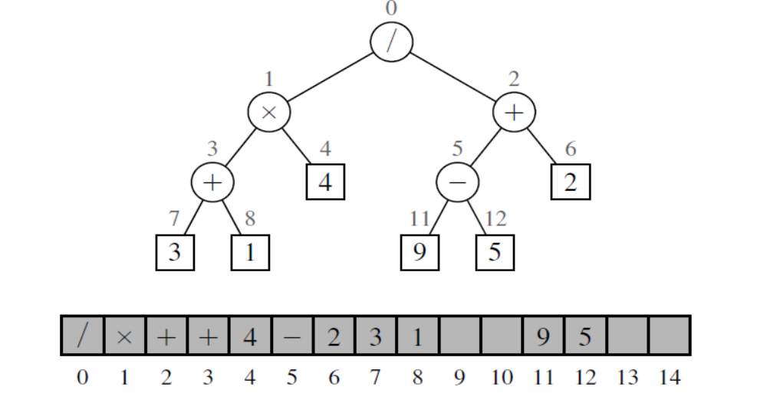
Example of using Lists to present Binary Tree
© 2013 Goodrich, Tamassia, Goldwasser
Trees
Notes:
Trees

